Slide 1
NB-IoT Test Procedure Overview
Goal: to evaluate the operational security posture of NB-IoT compared to Mist by simulating replay-style attack scenarios in a controlled lab environment.
Focus: observe protocol behavior under manipulation, specifically how devices respond when legitimate network messages are dropped, delayed, or replayed at a gateway level.
Measuring:
Integrity of message delivery
Availability of device reporting
Battery/resource exhaustion risk
Operational cost impact

Slide 2
How Tests Will Be Conducted
The test environment will include:
NB-IoT dev kit (the device under test)
Raspberry Pi acting as a gateway proxy (controlled middleman layer between device & server)
Linux VM for logging, packet capture, and replay tooling
USB inline power meter for battery/power measurement
Mist gateway + tags for comparison testing
Key Component is the Raspberry Pi Gateway
Allows us to safely simulate a compromised relay point by controlling traffic between the device and server

Slide 3
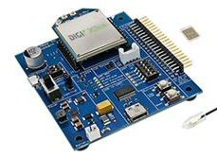
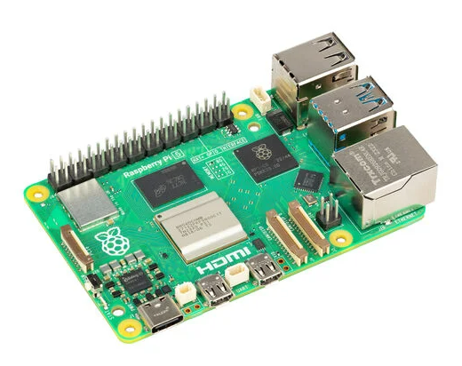
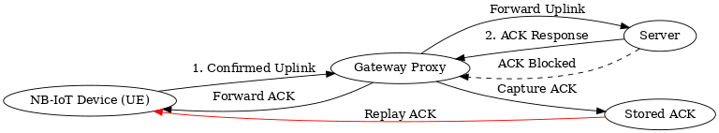
ACK Replay via Gateway Proxy
Relay Spoofing and Fake Delivery Confirmation
Integrity + Availability + Resource Exhaustion
Notes:
ACK = a confirmation message that lets the device know “we received your data”. The device relies on that confirmation to know whether it needs to resend the message or move on.
In the ACK replay test, we’re checking whether the device trusts a replayed confirmation message even when the server never actually received the original data.
Configure the NB-IoT device to send confirmed uplink messages at a fixed time interval
Capture ACK traffic using packet capture tools
Temporarily block real ACKs from reaching the device
Replay previously captured ACK messages from the proxy (Raspberry Pi)
Observe whether the device accepts the replayed confirmation

Slide 4
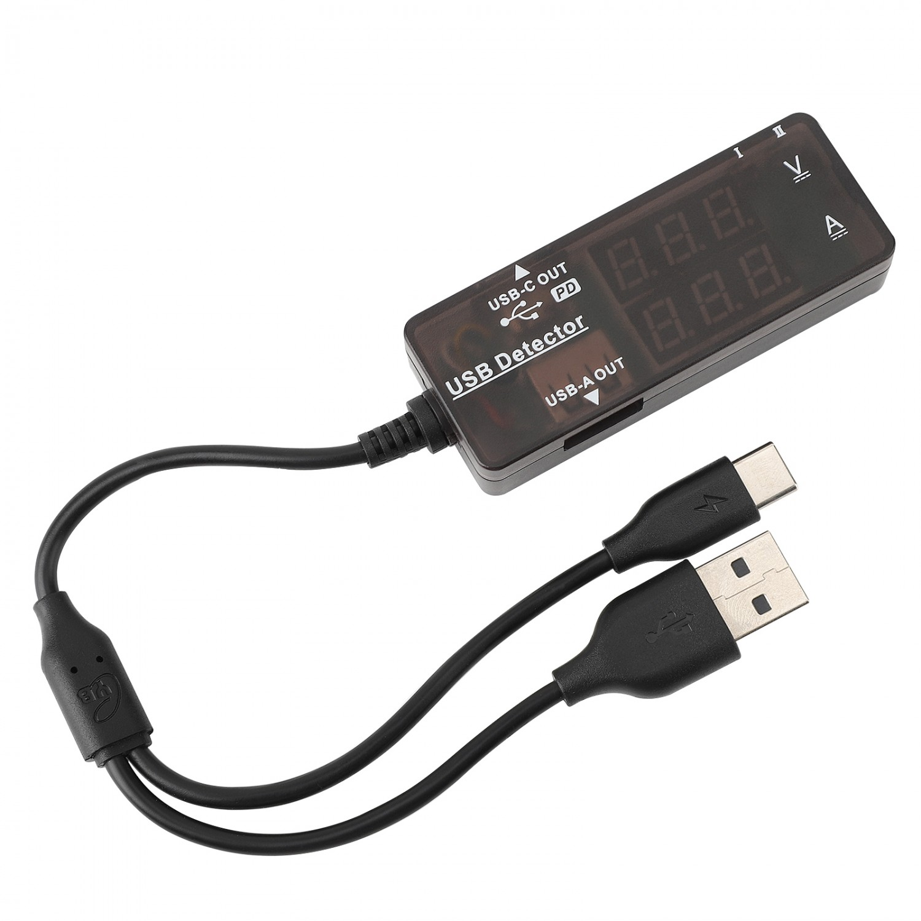
Replay Flood Battery Exhaustion
Resilience Testing and Resource Exhaustion
Availability + Denial of Service + Cost of Failure
Notes:
This test allows us to quantify battery-life impact
Testing to see whether replayed traffic can increase CPU activity, drain battery faster, and disrupt reporting cadence
The proxy captures a legitimate downlink message, repeatedly replays it to the device, and we measure the resulting power consumption, wake cycles, and retry behavior.
Capture a legitimate downlink message that triggers device processing.
Replay that message repeatedly from the gateway proxy at a controlled rate.
Measure device response using logging tools and the USB power meter.

